Slide 1
DETECTING LANE LINES FOR VEHICLES
Data 690-Applied Artificial Intelligence
Team Members: Drishti Arora
Parth Soni

Slide 2
PROJECT OVERVIEW
Holding the car in its lane is one of the most common tasks when driving, though it is likely ignored due to its frequent use when a person drives a car.
Lane detection is an important part of an autonomous driving system because it ensures that the safety requirements of a road accident are met.
Lane detection is difficult for a computer because it does not understand what yellow and white stripes on a road are, nor does it understand the shifts in pixel values between those and the pixels representing the road in a video stream.
To help computer learn white and yellow streaks on road and detecting lanes is a computer vision problem and can be solved using various computer vision techniques or deep learning.

Slide 3
PROBLEM STATEMENT
In certain driving situations, human beings do a good job of distinguishing lane line markers when they are completely attentive. Computers aren't born with the ability to do the same. People, on the other hand, have the downside of not always being attentive, while a robot is not.
Computer vision techniques will be used to detect the lane lines.
Also, using deep learning, a Convolutional Neural Network model will be trained which will be robust at detecting lane lines.

Slide 4
ANALYSIS
Dataset:
For dataset, we got some images and labels dataset from Kaggle. There are 12,764 images for training which are a mix of different times of day, weather and traffic including straight and curvy lanes along with their labels.
Algorithm and Technique:
Detecting lanes(Computer Vision): Converting image to grayscale image, canny transformation, region of interest and Hough transformation.
The CNN model: Training ,testing and predicting lane lines.
Testing: We test our model by predicting lane lines in a test video. We will see how accurately it matches with the lanes on road.

Slide 5
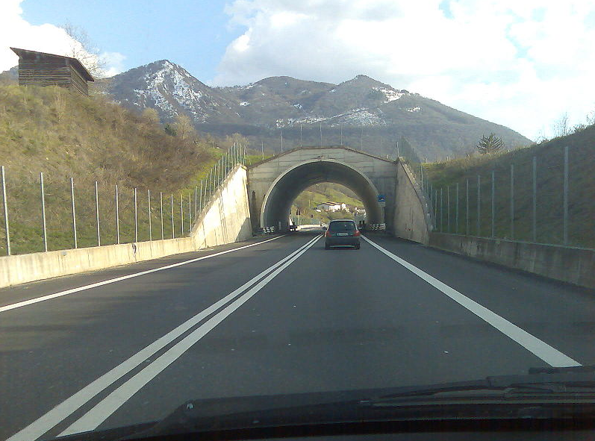
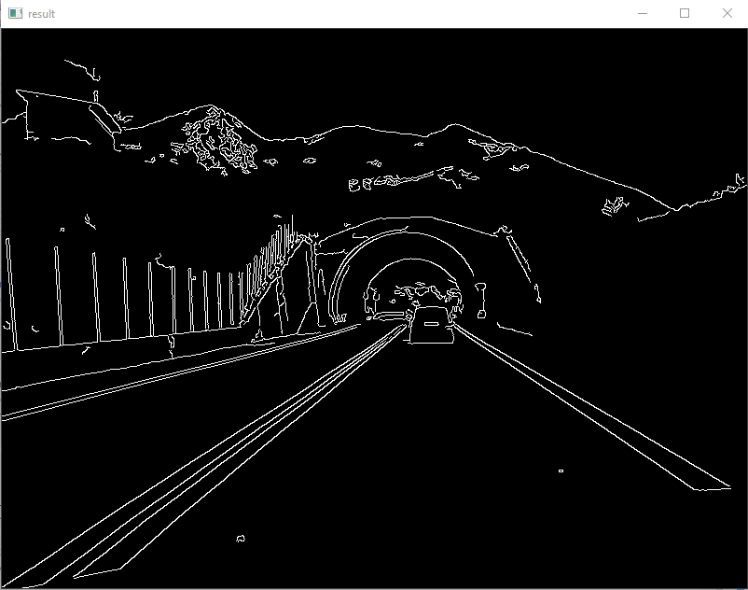
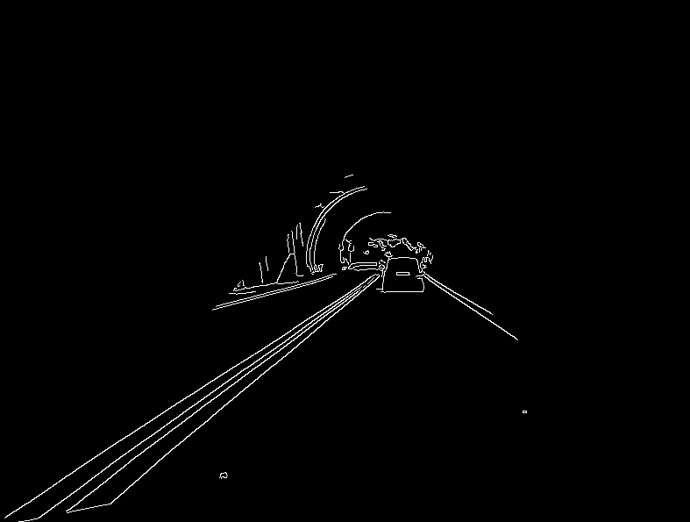
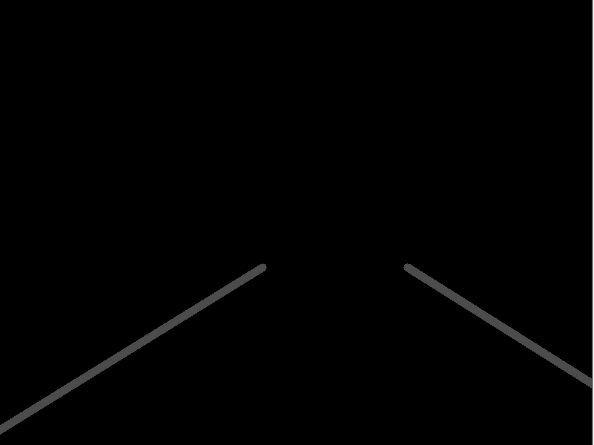
Detecting lanes(Computer Vision) for labels:
1. Converting Image to GrayScale Image
2. Applying Canny Transform
3. Selecting only our region of interest
4. Hough Transformation for detecting lines.

Slide 6
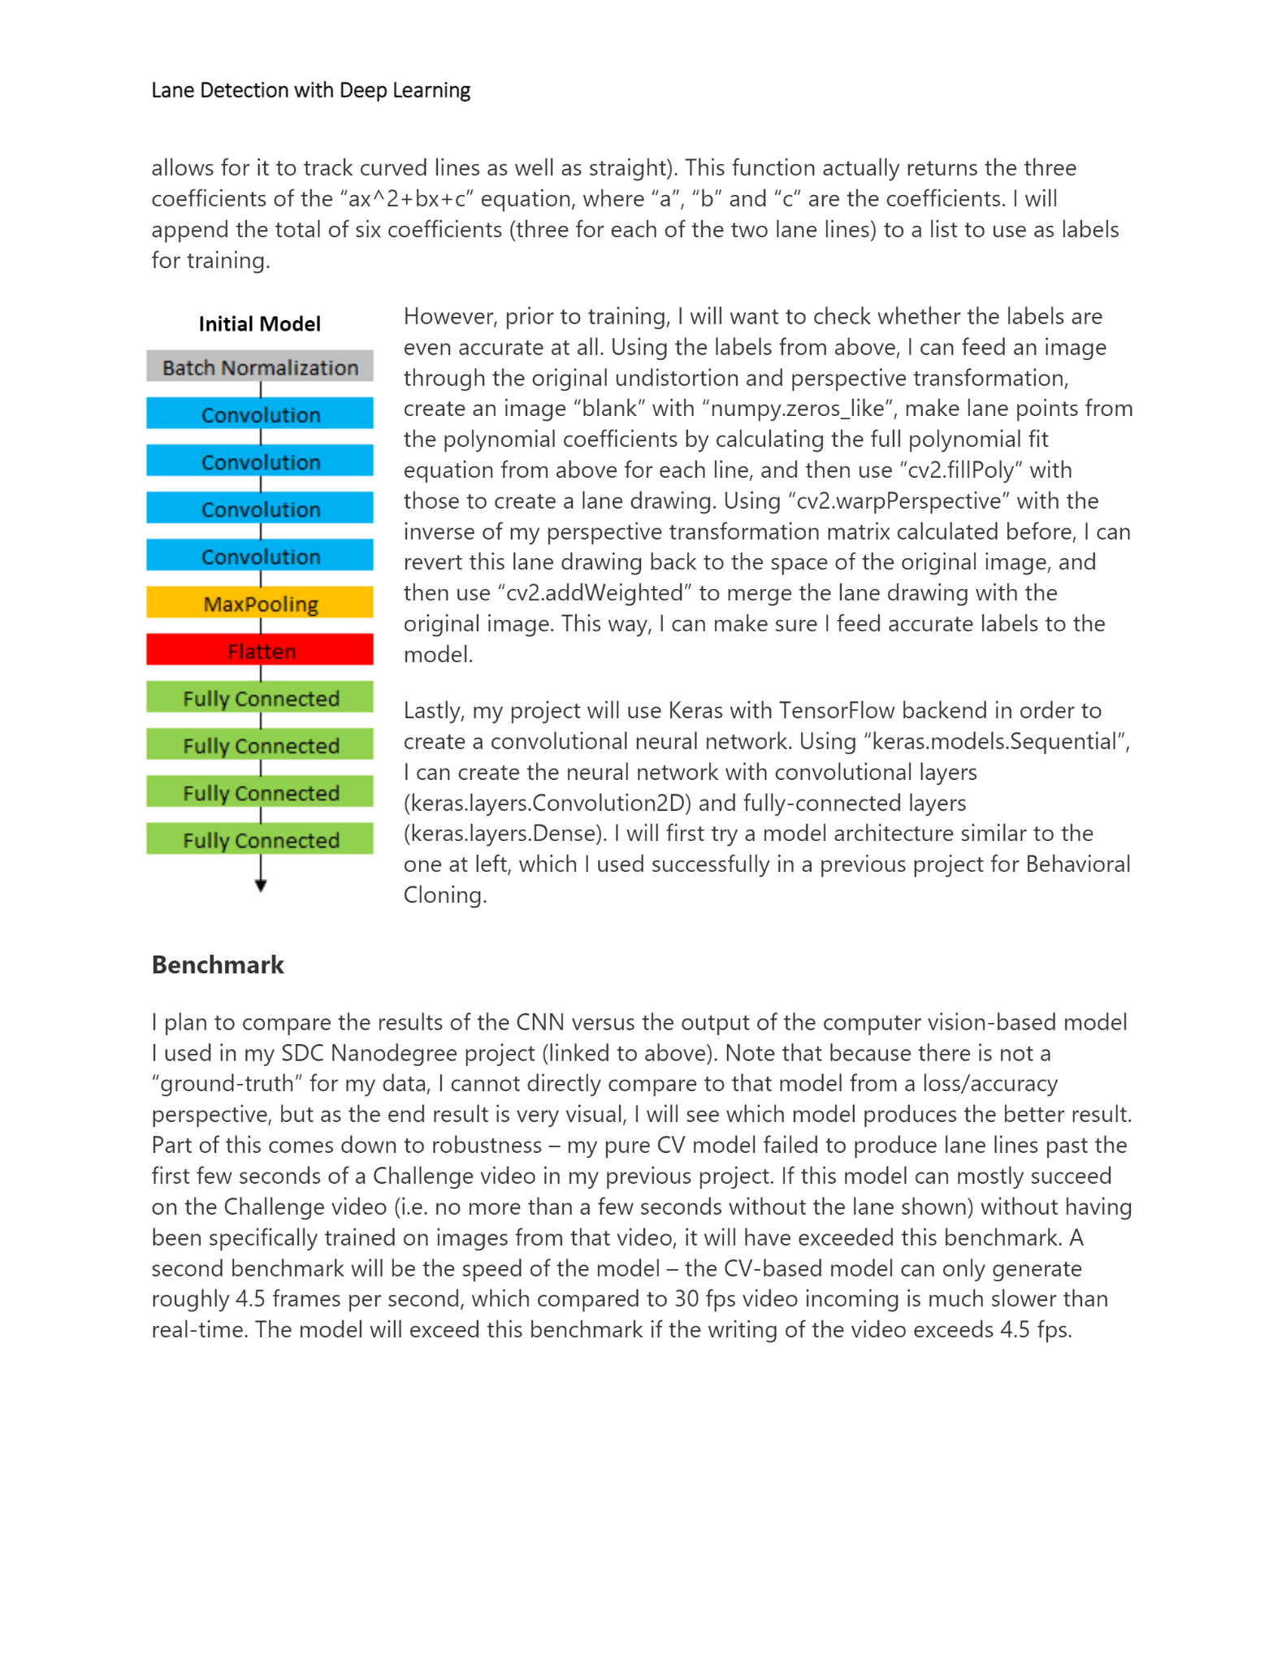
Why CNN? (deep learning model)
CNNs are very effective in reducing the number of parameters without losing on the quality of models.
Images have high dimensionality (as each pixel is considered as a feature) which suits the above described abilities of CNNs.
Also, CNNs were developed keeping images into consideration. CNNs are trained to identify the edges of objects in any image.

Slide 7
Challenges
Costs:
We would need a camera around the center of the car that would cost us around 50 to 200$ with installation.
Then, Implementing our code for the live video feed from camera is difficult and the system will be expensive.
Finally, we need an alarm system which beeps if the car is not in the right lane.
Labeling the images with computer vision took a lot of effort.
With our data being huge, we either had to reduce the data or epochs which would result in lower accuracy.

Slide 8
References
https://github.com/mvirgo/MLND-Capstone
https://medium.com/@ishwarsawale/lane-detection-bdfdb971f73
https://medium.com/@mrhwick/simple-lane-detection-with-opencv-bfeb6ae54ec0
THANK YOU!

